Slide 1


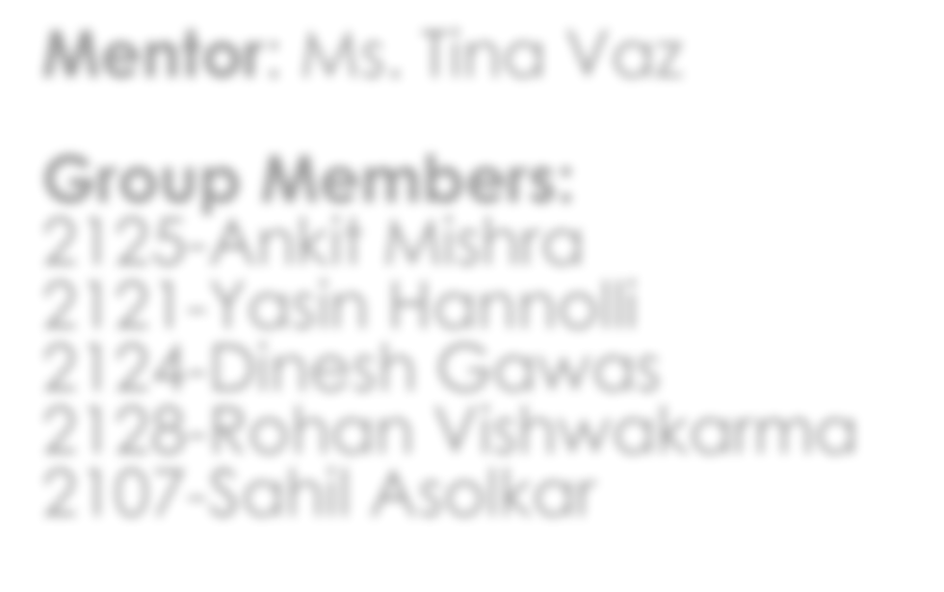
SBSI 2021-22
Trash Scanner
Mentor: Ms. Tina Vaz
Group Members:
2125-Ankit Mishra
2121-Yasin Hannolli
2124-Dinesh Gawas
2128-Rohan Vishwakarma 2107-Sahil Asolkar

Slide 2

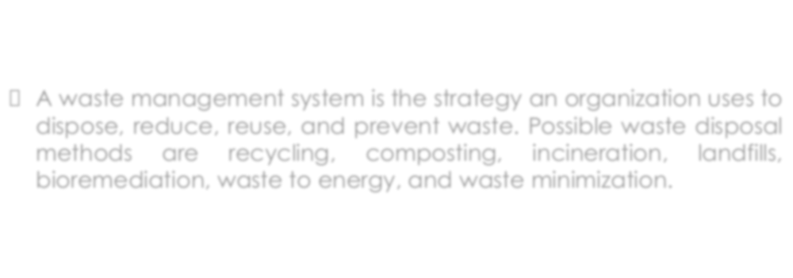
What is waste management?
□ A waste management system is the strategy an organization uses to dispose, reduce, reuse, and prevent waste. Possible waste disposal methods are recycling, composting, incineration, landfills, bioremediation, waste to energy, and waste minimization.

Slide 3

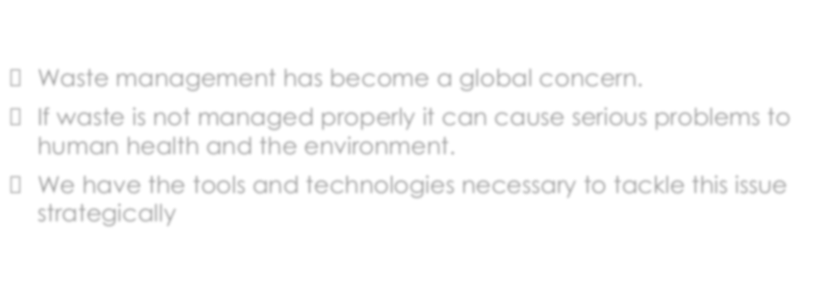
Why Waste Management?
Waste management has become a global concern.
If waste is not managed properly it can cause serious problems to human health and the environment.
We have the tools and technologies necessary to tackle this issue strategically.

Slide 4

About the Application

Slide 5
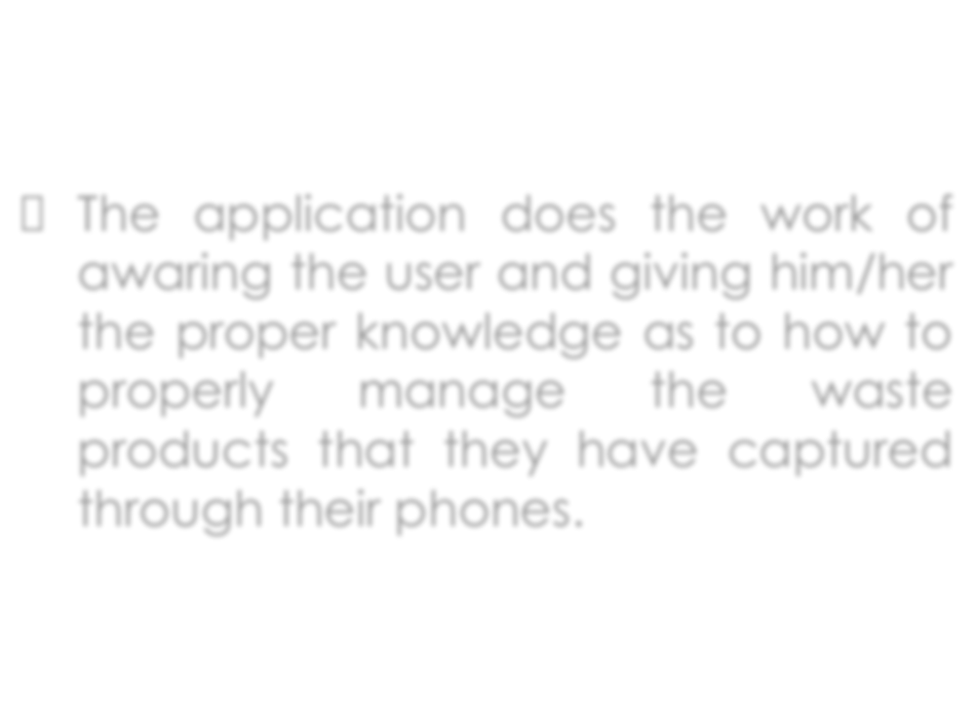

□ The application does the work of awaring the user and giving him/her the proper knowledge as to how to properly manage the waste products that they have captured through their phones.

Slide 6

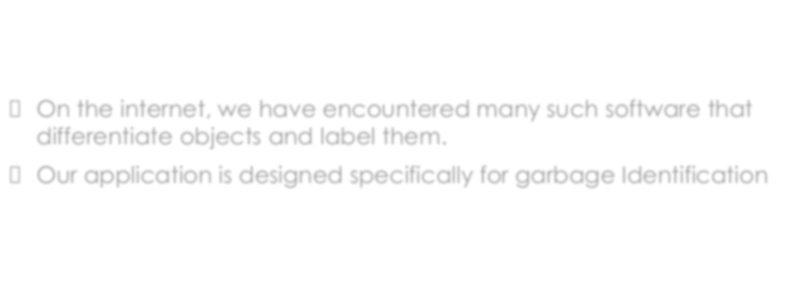
Unique Selling Point
On the internet, we have encountered many such software that differentiate objects and label them.
Our application is designed specifically for garbage Identification

Slide 7

Work Done

Slide 8

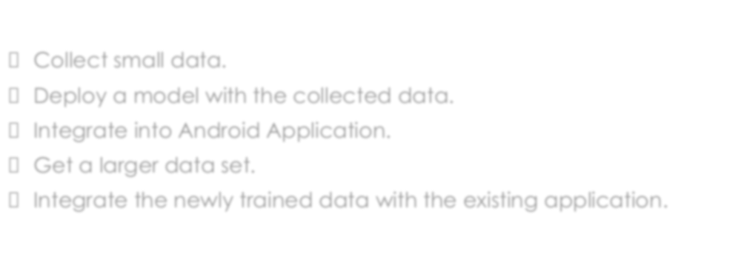
Planning
Collect small data.
Deploy a model with the collected data.
Integrate into Android Application.
Get a larger data set.
Integrate the newly trained data with the existing application.

Slide 9

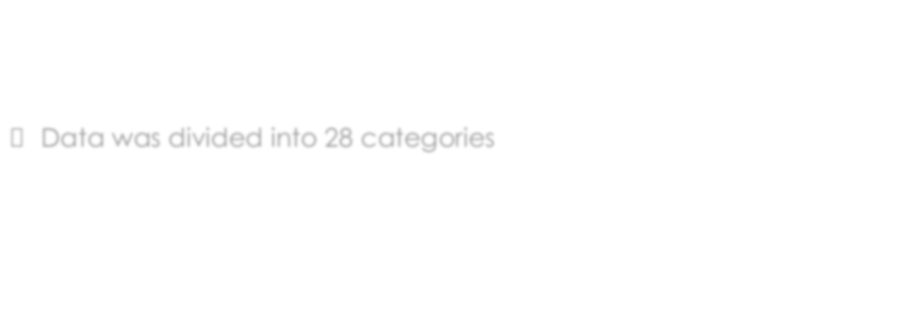
Execution of Plan
□ Data was divided into 28 categories

Slide 10
Plastic bag & wrapper Cigarette
Unlabelled litter Bottle
Bottle cap Other plastic Can
Carton Cup Straw Paper
Broken glass Styrofoam piece Pop tab
Lid
Plastic container Aluminum foil Plastic utensils Rope & strings Paper bag Scrap metal Food waste Shoe
Blister pack Squeezable tube Glass jar
Plastic gloves

Slide 11
Data annotation
Every image that we had, they had to go under a process which was completely manual
Marking :
Here the images were marked with a rectangle so as to cover the entire object in the image
Rename:
Here the picture was renamed for convenience
Categorize:
Here the image would be categorized into one of the 28 categories that we had listed.

Slide 12

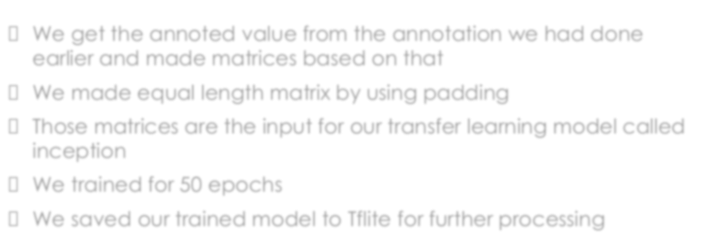
Training data
We get the annoted value from the annotation we had done earlier and made matrices based on that
We made equal length matrix by using padding
Those matrices are the input for our transfer learning model called inception
We trained for 50 epochs
We saved our trained model to Tflite for further processing

Slide 13


Tools and technologies
TensorFlow
Android Studio
Machine learning

Slide 14

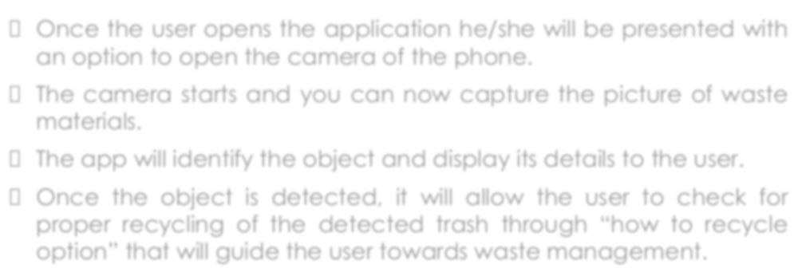
Working
Once the user opens the application he/she will be presented with an option to open the camera of the phone.
The camera starts and you can now capture the picture of waste materials.
The app will identify the object and display its details to the user.
Once the object is detected, it will allow the user to check for proper recycling of the detected trash through “how to recycle option” that will guide the user towards waste management.

Slide 15
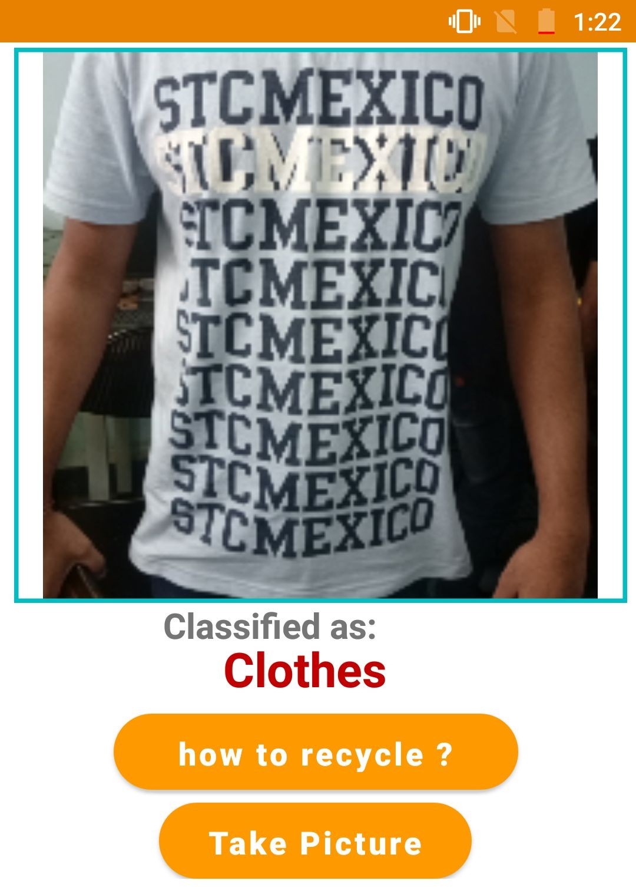
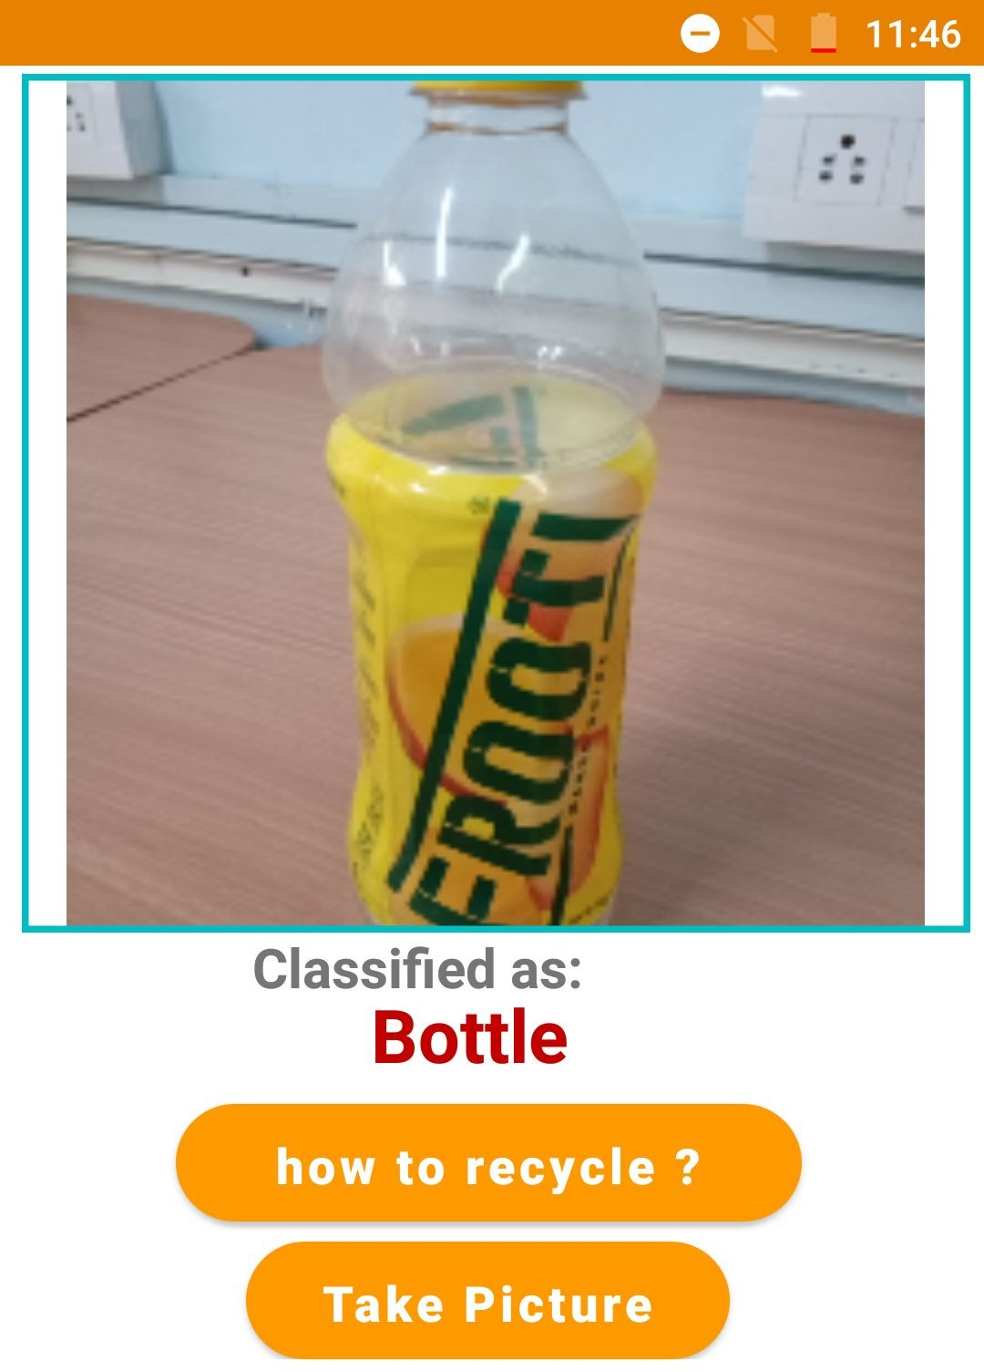

Slide 16
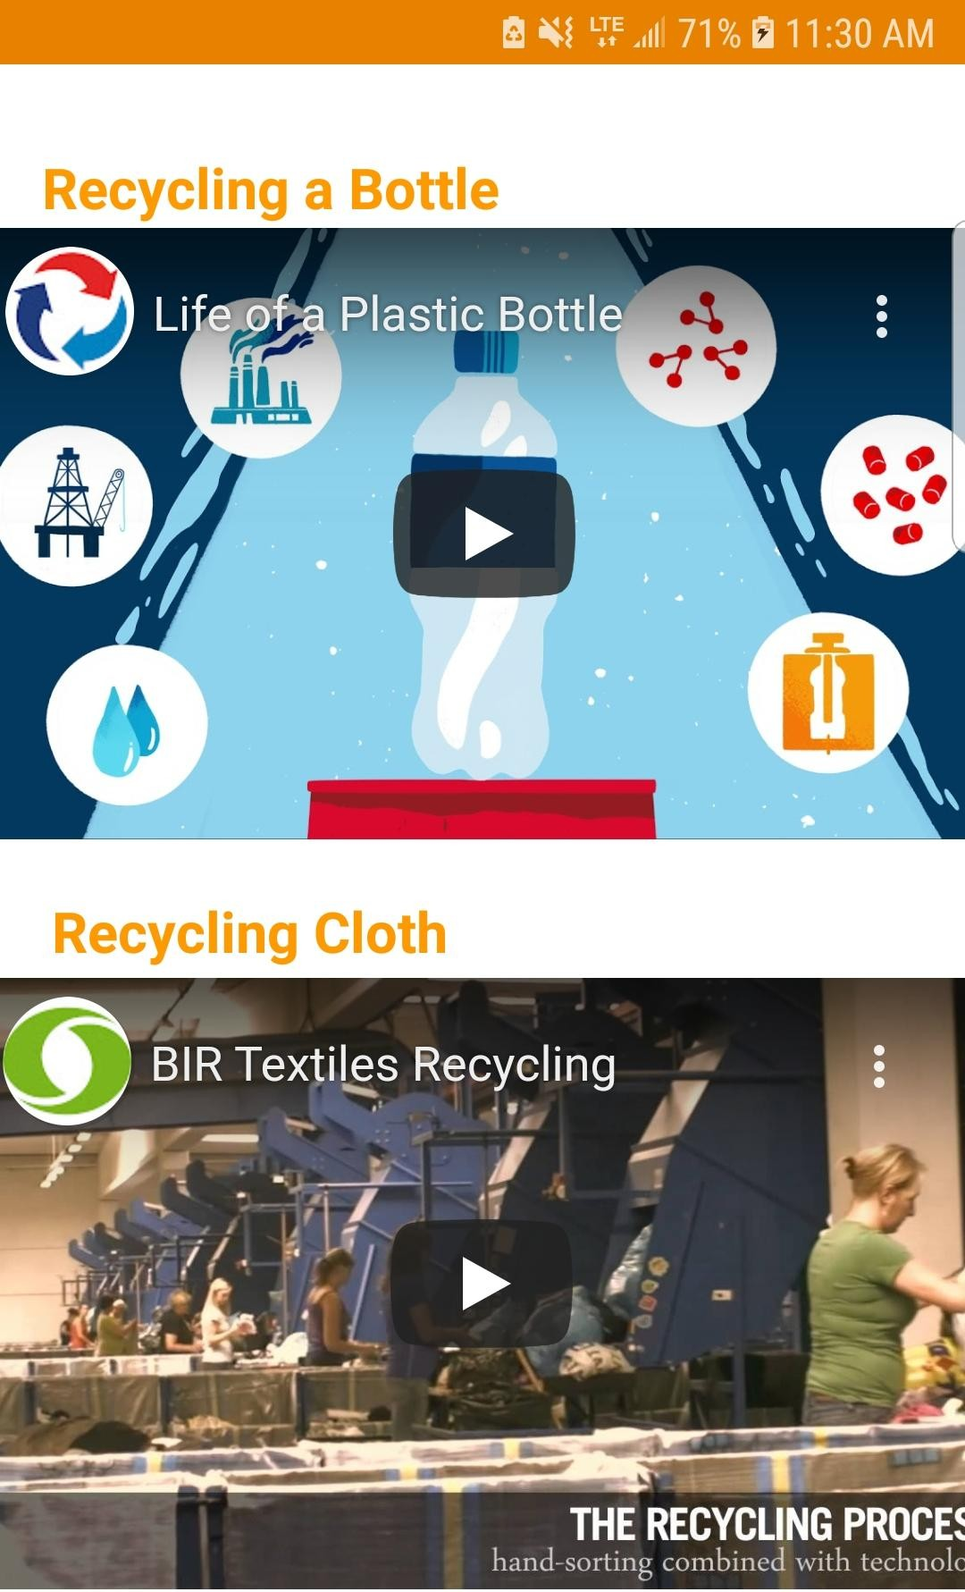

Slide 17


Understanding Energy management systems through Augmented Reality
Additional work

Slide 18

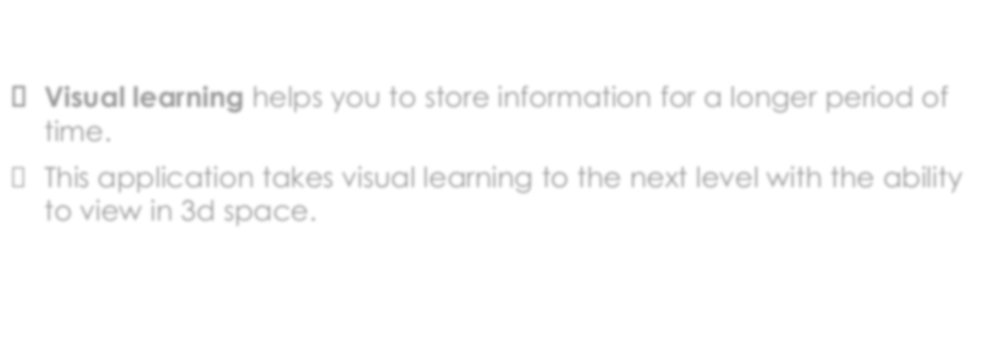
About the application
□ Visual learning helps you to store information for a longer period of time.
□ This application takes visual learning to the next level with the ability to view in 3d space.

Slide 19

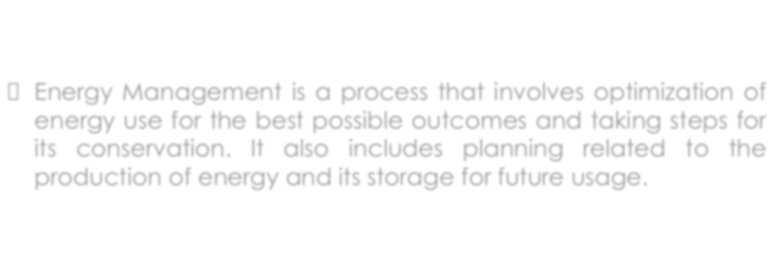
What is Energy management?
□ Energy Management is a process that involves optimization of energy use for the best possible outcomes and taking steps for its conservation. It also includes planning related to the production of energy and its storage for future usage.

Slide 20
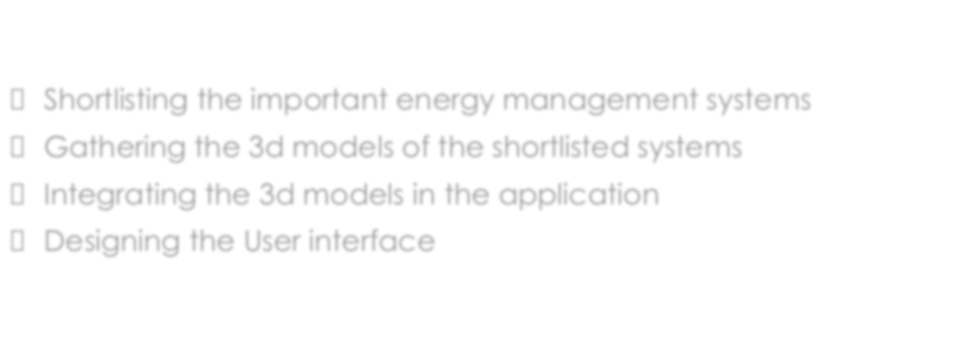
Planning
Shortlisting the important energy management systems
Gathering the 3d models of the shortlisted systems
Integrating the 3d models in the application
Designing the User interface

Slide 21


Execution
A total of 4 energy management systems were shortlisted:
Windmill
Dam
Nuclear power plant
Solar panels

Slide 22

Tools and technologies
Unity 3D
Vuforia

Slide 23
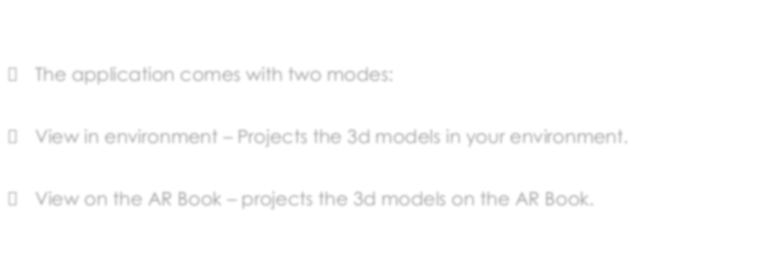
Working
The application comes with two modes:
View in environment – Projects the 3d models in your environment.
View on the AR Book – projects the 3d models on the AR Book.

Slide 24

Screenshots

Slide 25
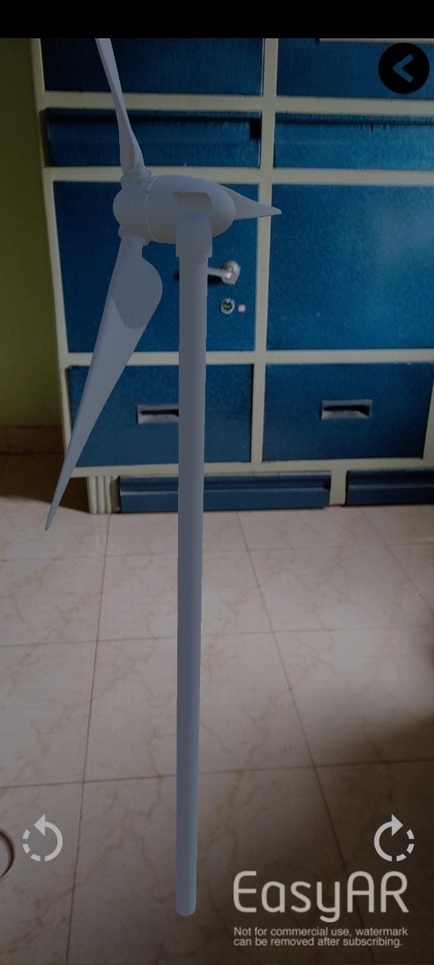
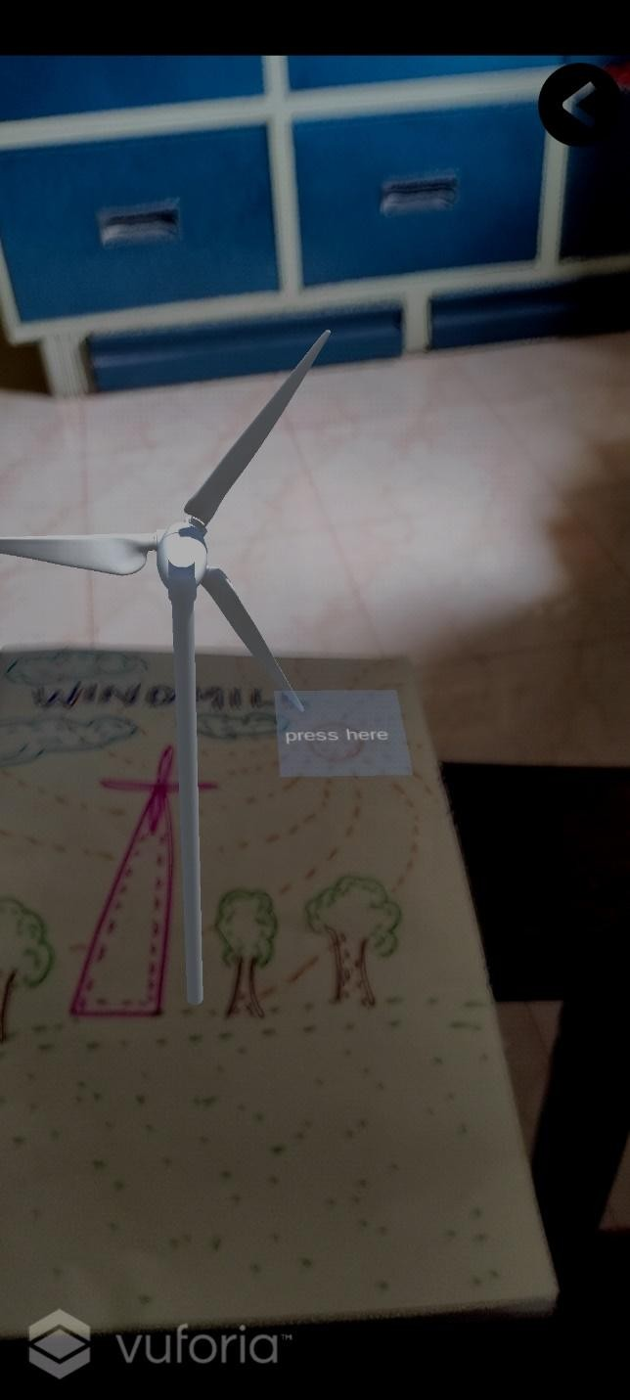
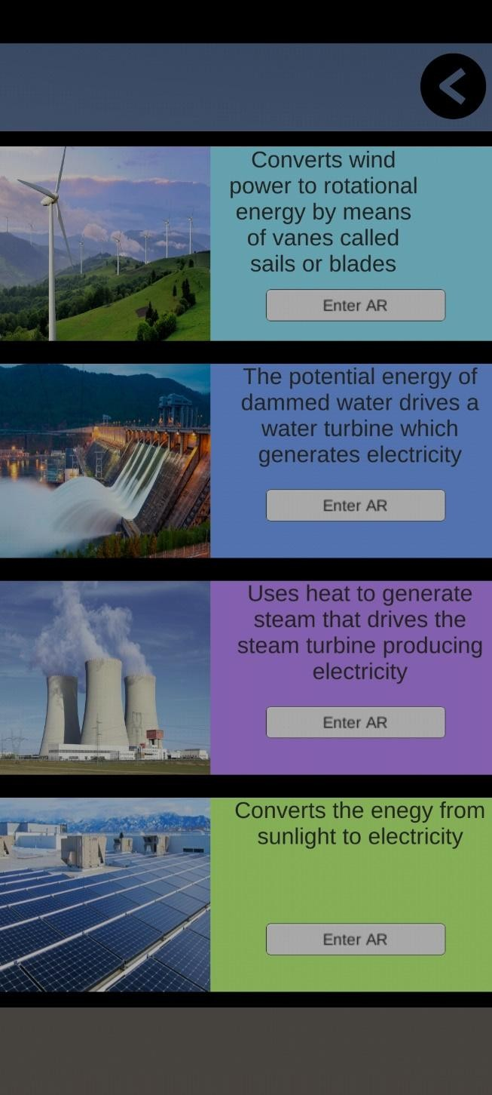

Slide 26

Campus Cleaning
Goa university

Slide 27
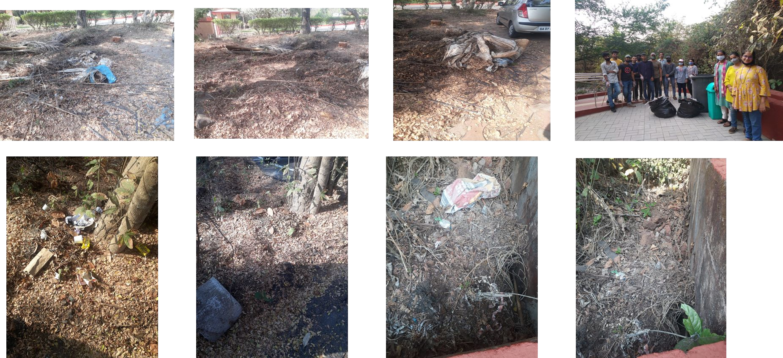

Slide 28

Cleanliness Drive
Bhedshi, Dodamarg

Slide 29
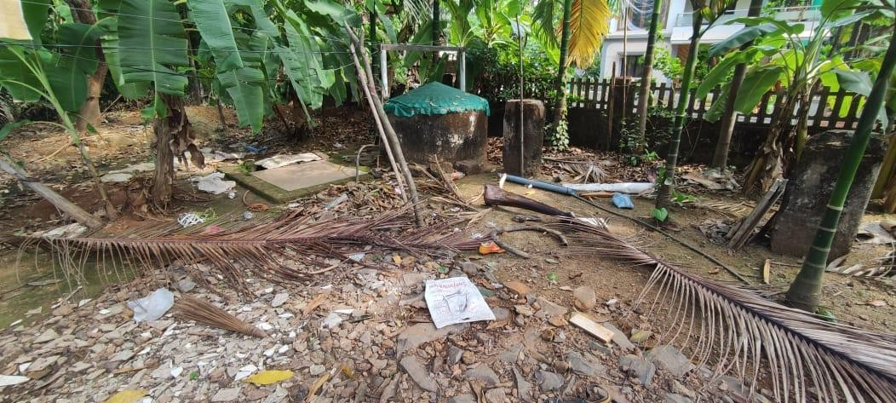
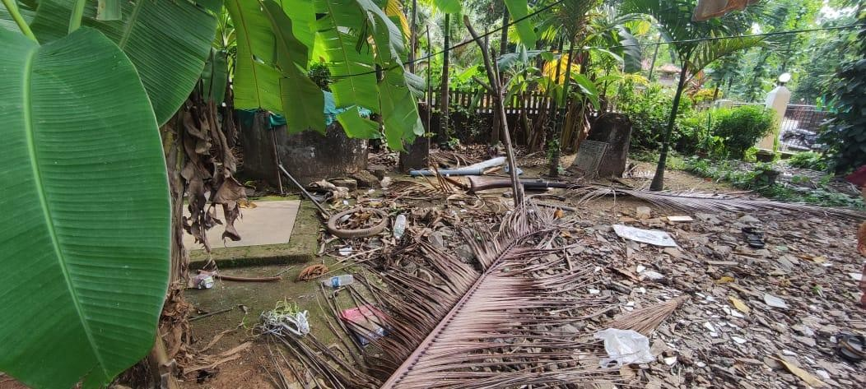
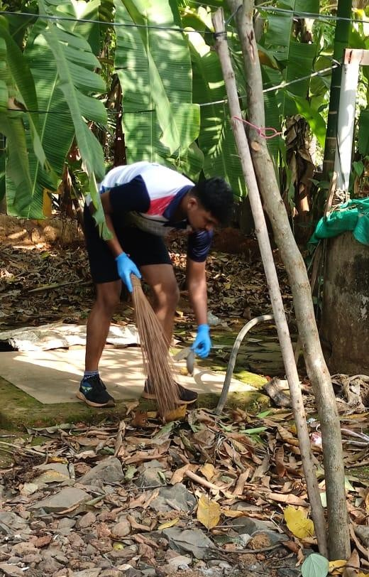
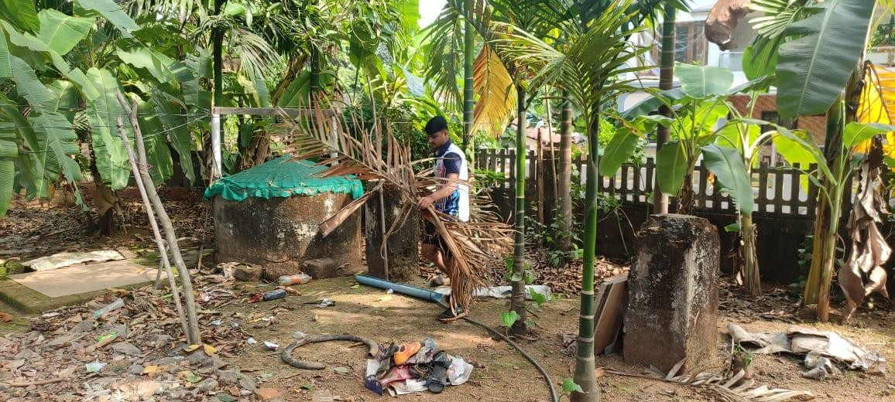
BEFORE

Slide 30
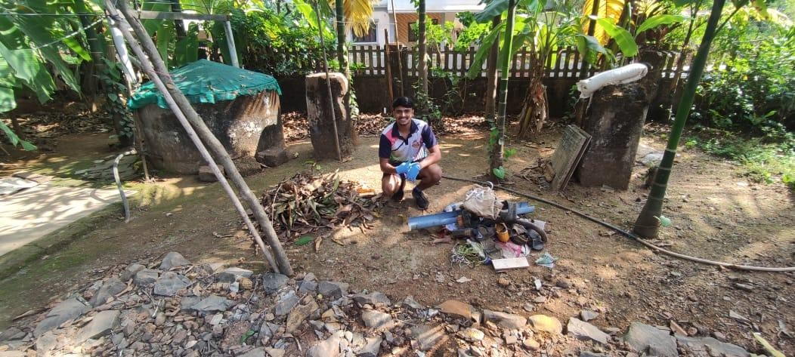
AFTER

Slide 31

Cleanliness Drive
Miramar

Slide 32
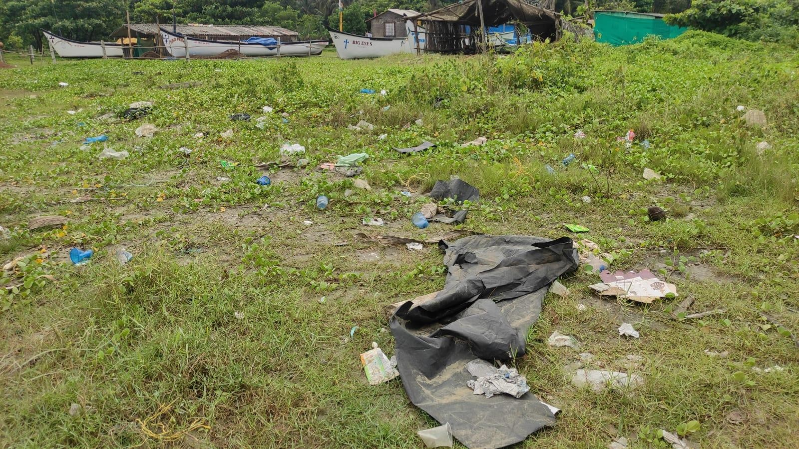
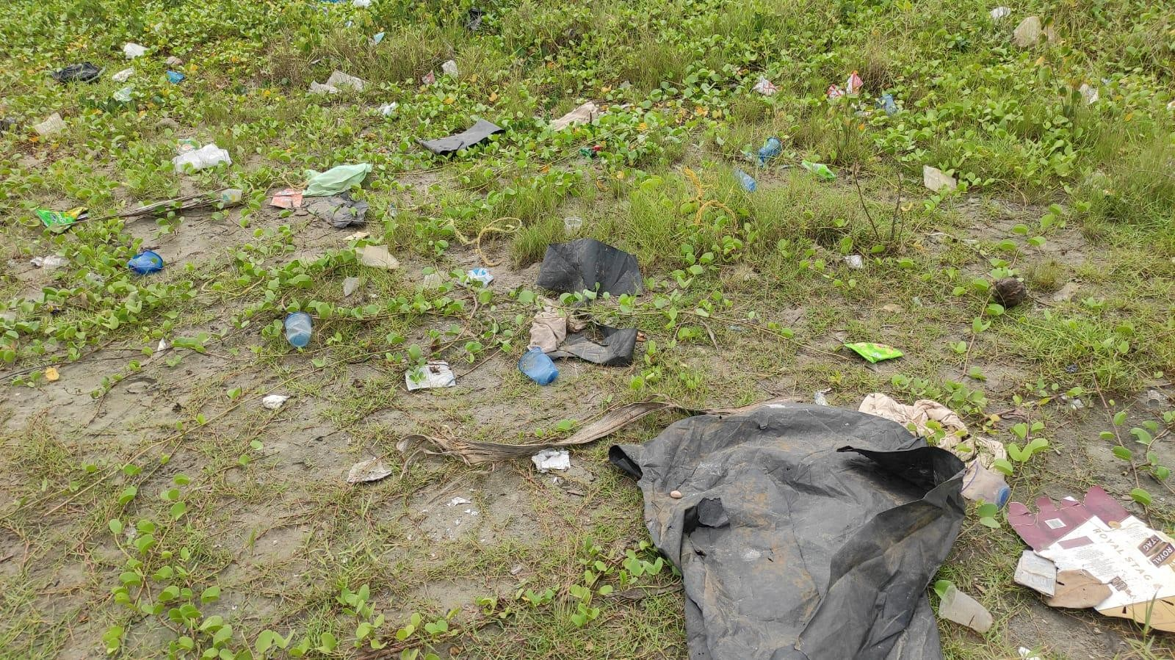
BEFORE

Slide 33
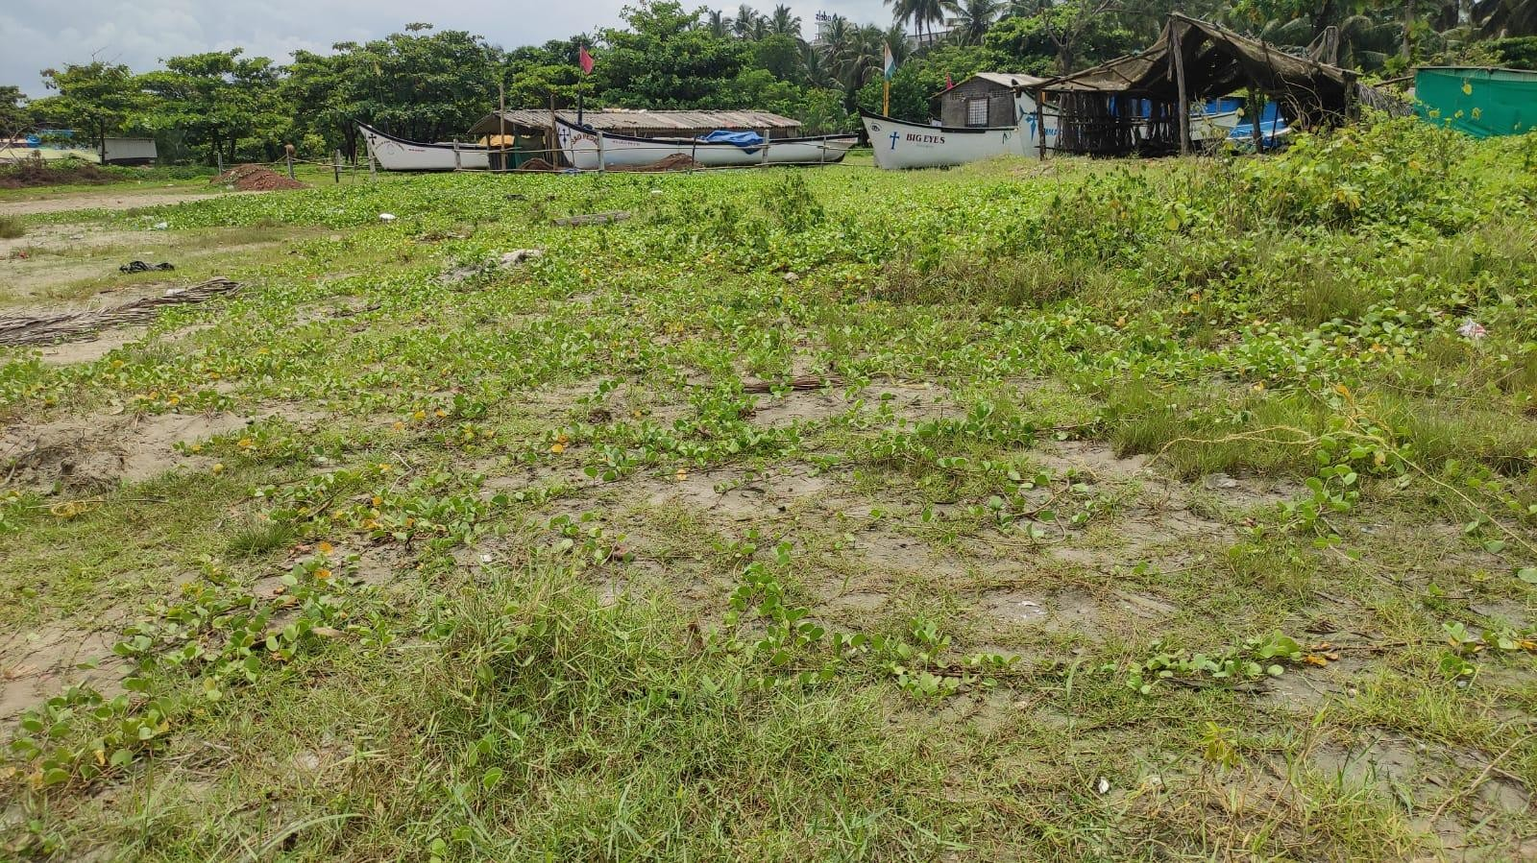
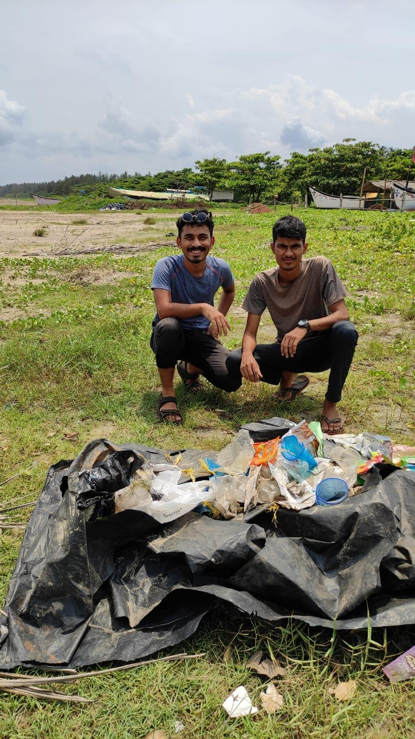
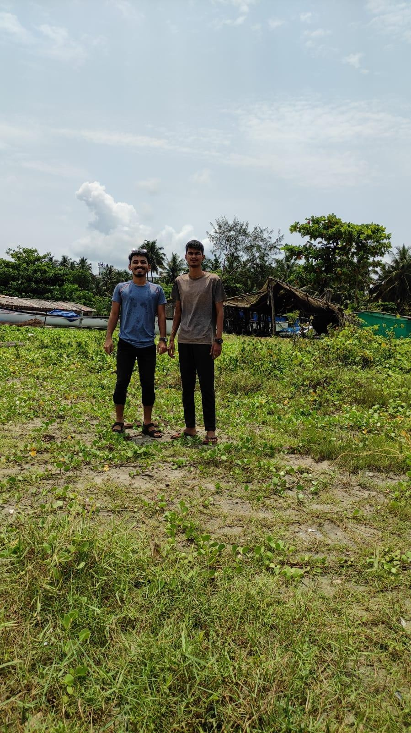
AFTER

Slide 34

Waste Management Service Visit
Ayya waste management service, Caranzalem, Panaji

Slide 35
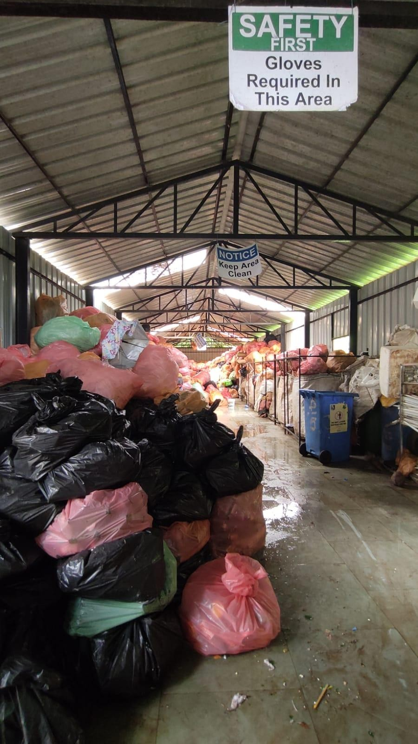
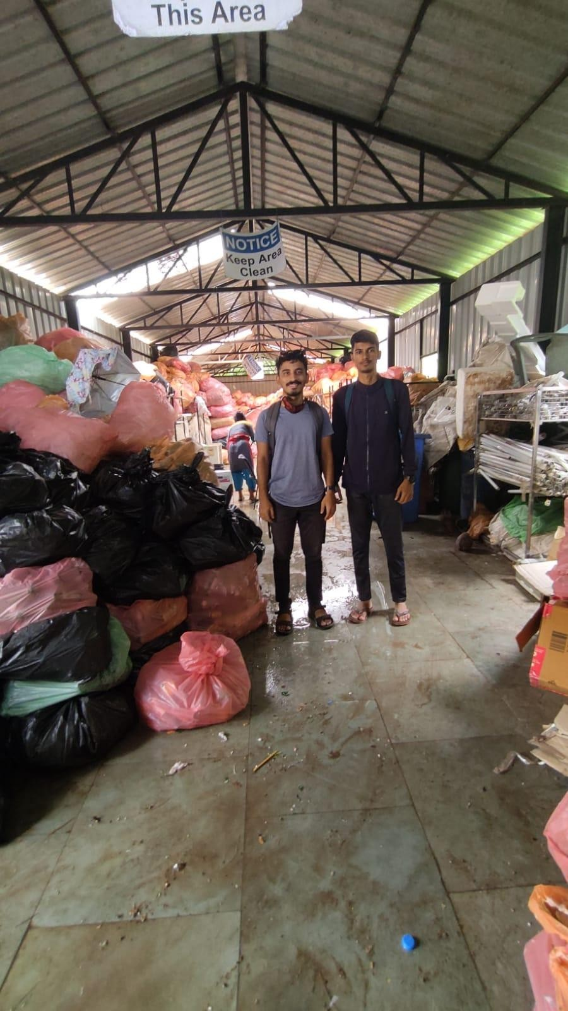
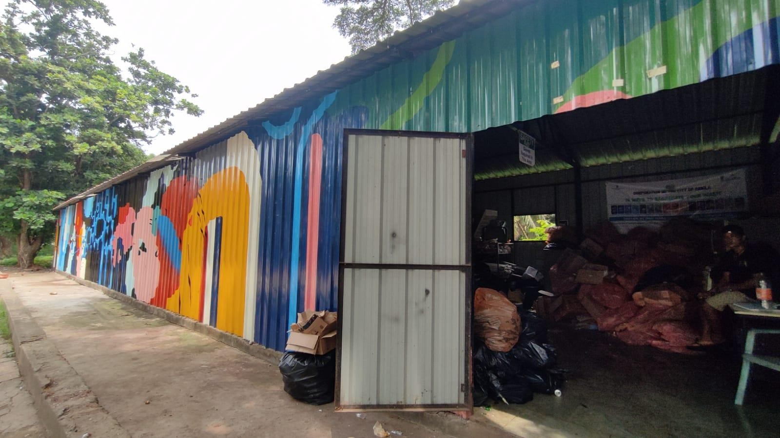

Slide 36

Timeline of Activities carried out

Slide 37
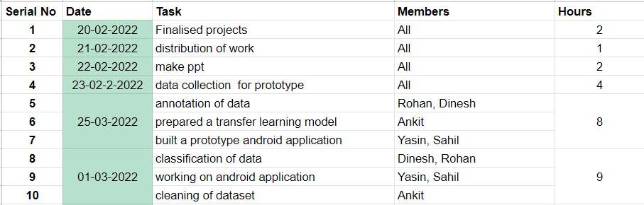

Slide 38
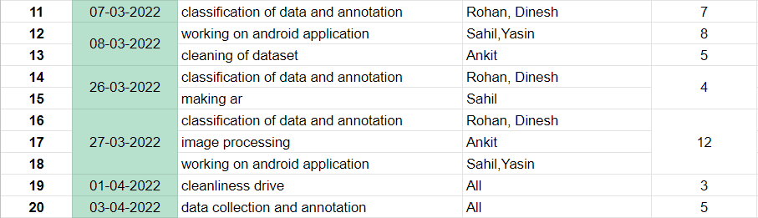

Slide 39
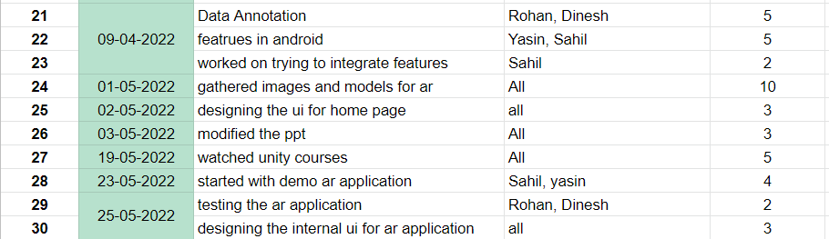

Slide 40
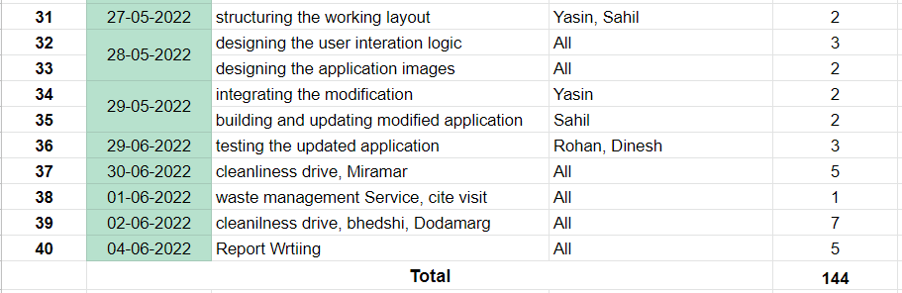

Slide 41

Outcome and Impact

Slide 42
New learnings
Team Building
Problem solving
Communication skills

Slide 43

Promotions

Slide 44

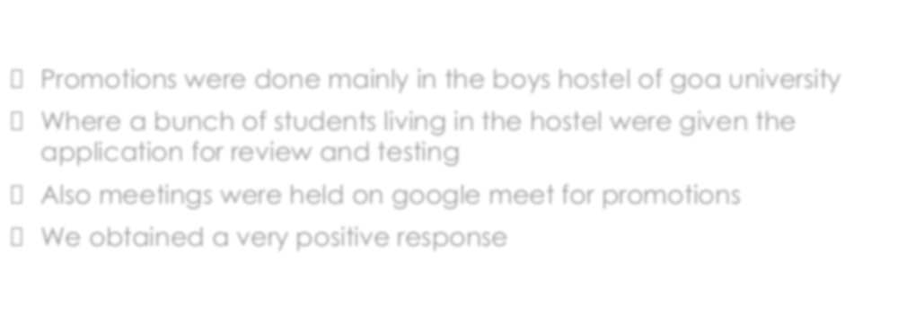
Promotions
Promotions were done mainly in the boys hostel of goa university
Where a bunch of students living in the hostel were given the application for review and testing
Also meetings were held on google meet for promotions
We obtained a very positive response and made changes according to it.

Slide 45
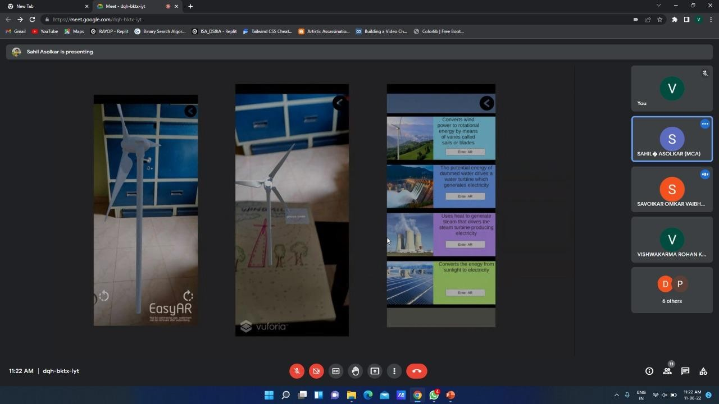
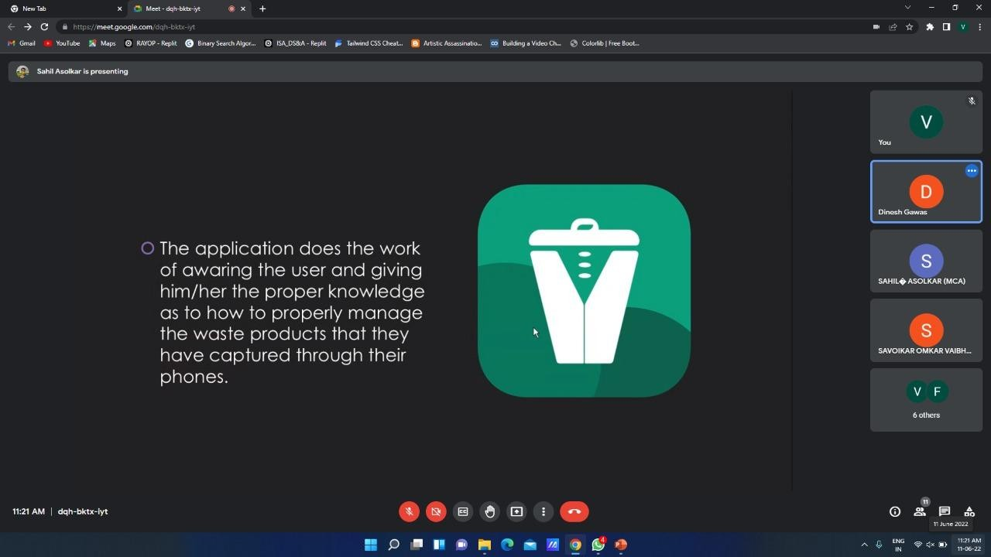
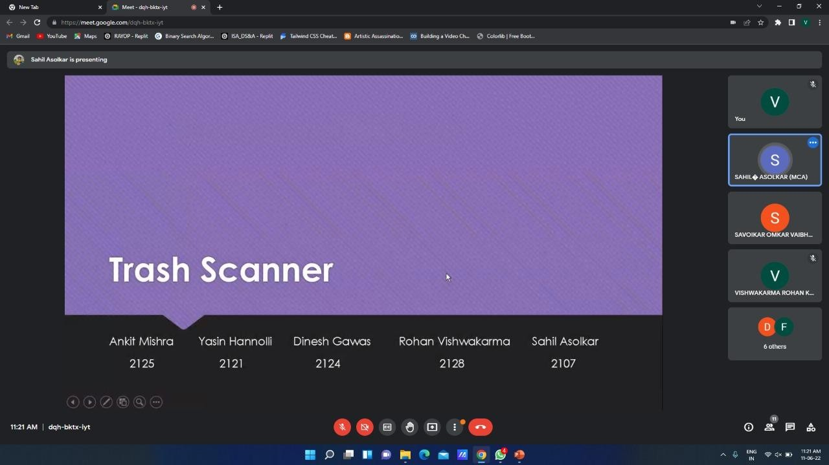
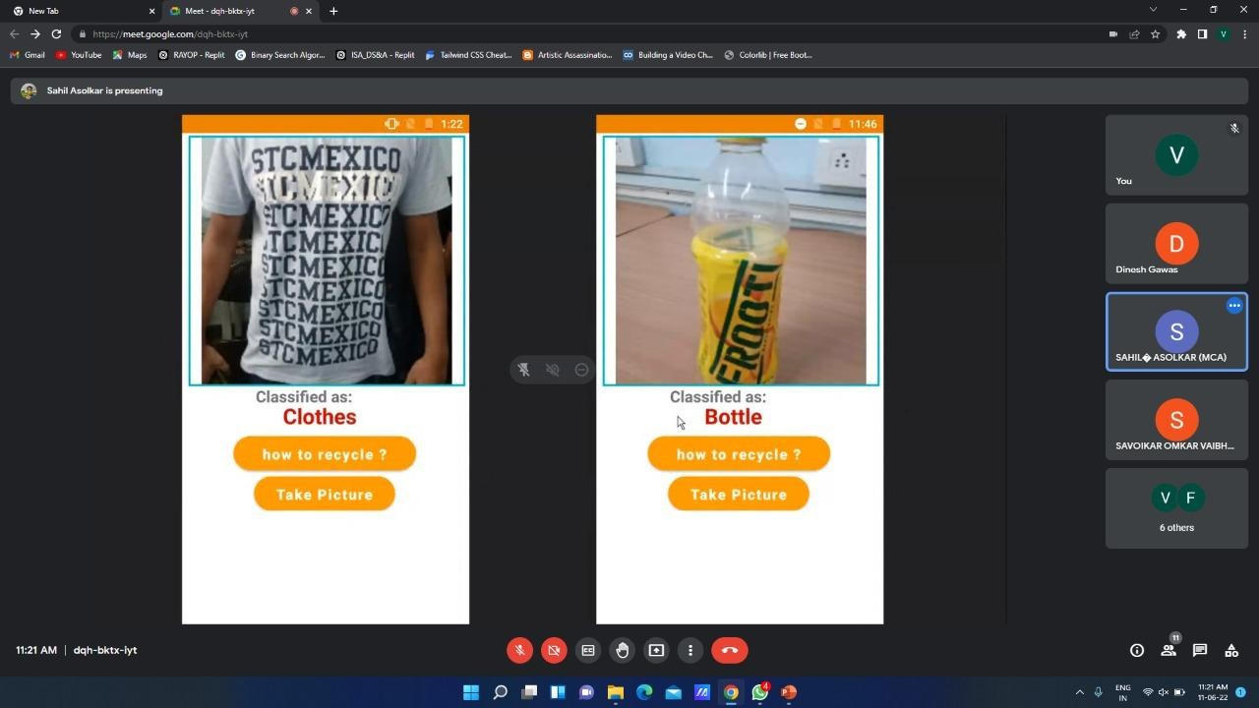

Slide 46

Takeaways of the SBSI 2021 COURSE

Slide 47
Enhanced our skills in some extra spaces like Machine Learning (ML), Android Studio and Augmented Reality(AR) .
Learnt skills that can be applied in real life
Over all a Positive effect on our mindset

Slide 48
Some Demonstration

Slide 51
Thank You

